Slide 1

PCWG 2016 Update
8th September 2016
Pamplona, Spain
Peter Stuart

Slide 2
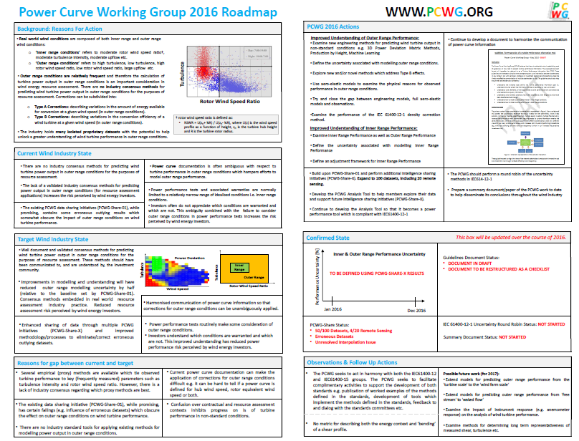

Slide 3
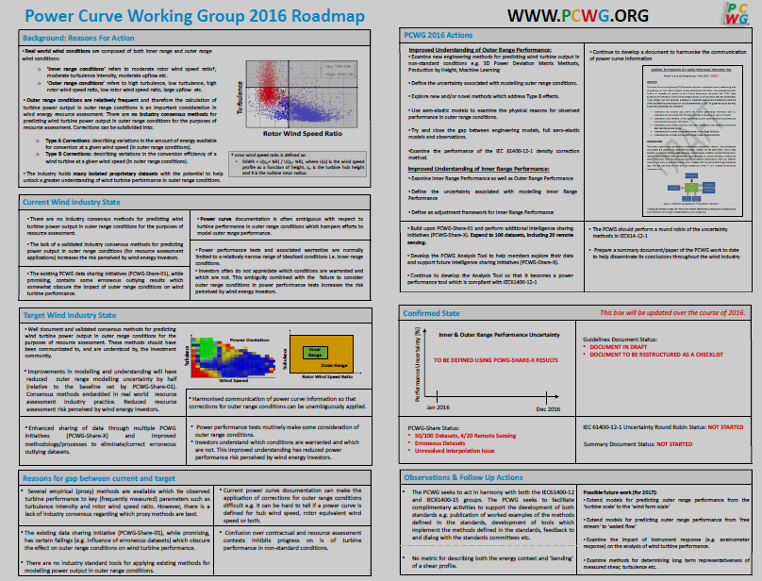
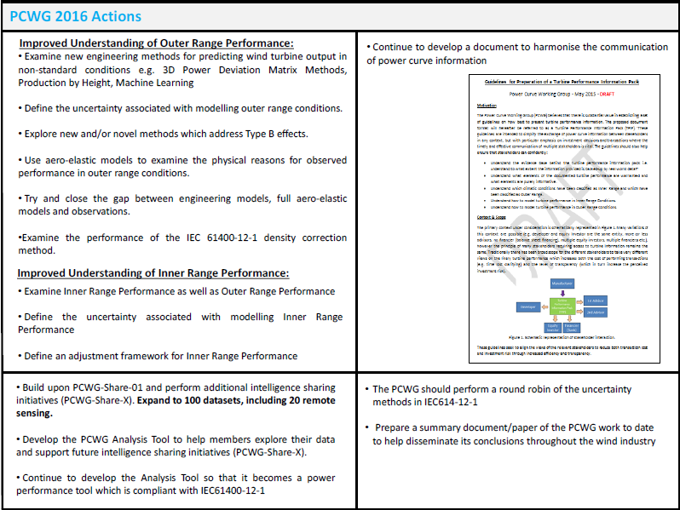

Slide 4
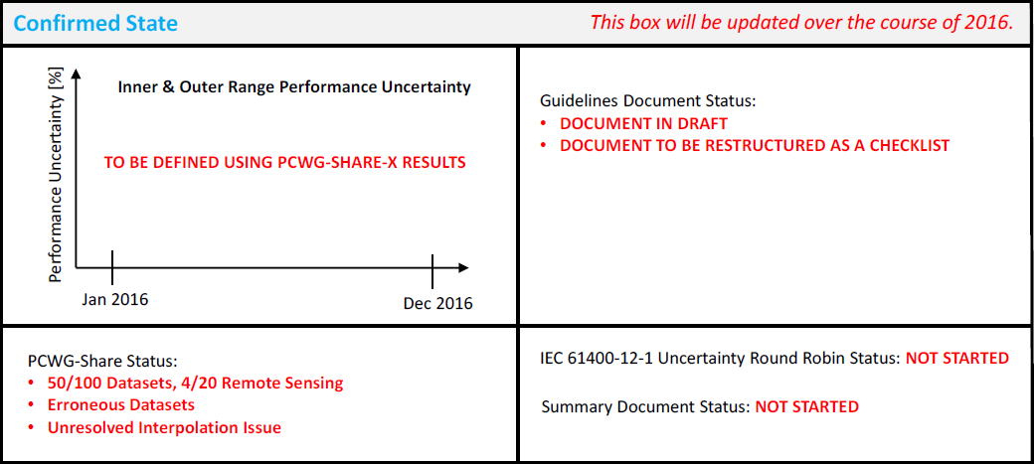

Slide 5
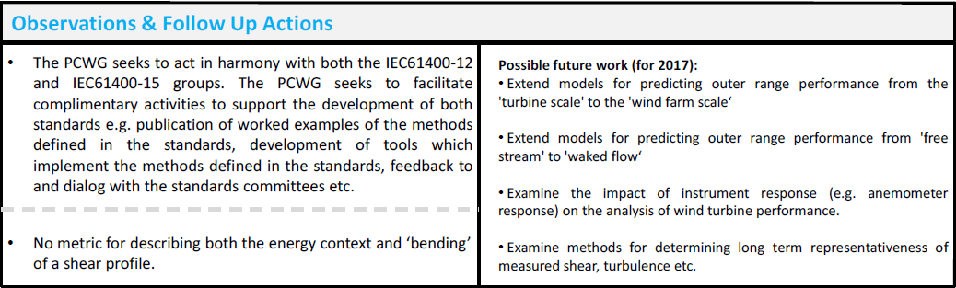

Slide 6
Join the Power Curve Working Group at: www.pcwg.org

